Slide 1
Lesson 4.6: Application: Image Classification
Class 1 Time series forecasting
Lesson 4.1 What is distributed Weka?
Class 2 Data stream mining in Weka and MOA
Lesson 4.2 Installing with Apache Spark
Class 3 Interfacing to R and other data mining packages
Lesson 4.3 Knowledge Flow templates I
Lesson 4.4 Knowledge Flow templates II
Class 4 Distributed processing with Apache Spark
Lesson 4.5 Moving to a cluster
Class 5 Scripting Weka in Python
Lesson 4.6 Application: Image Classification

Slide 2
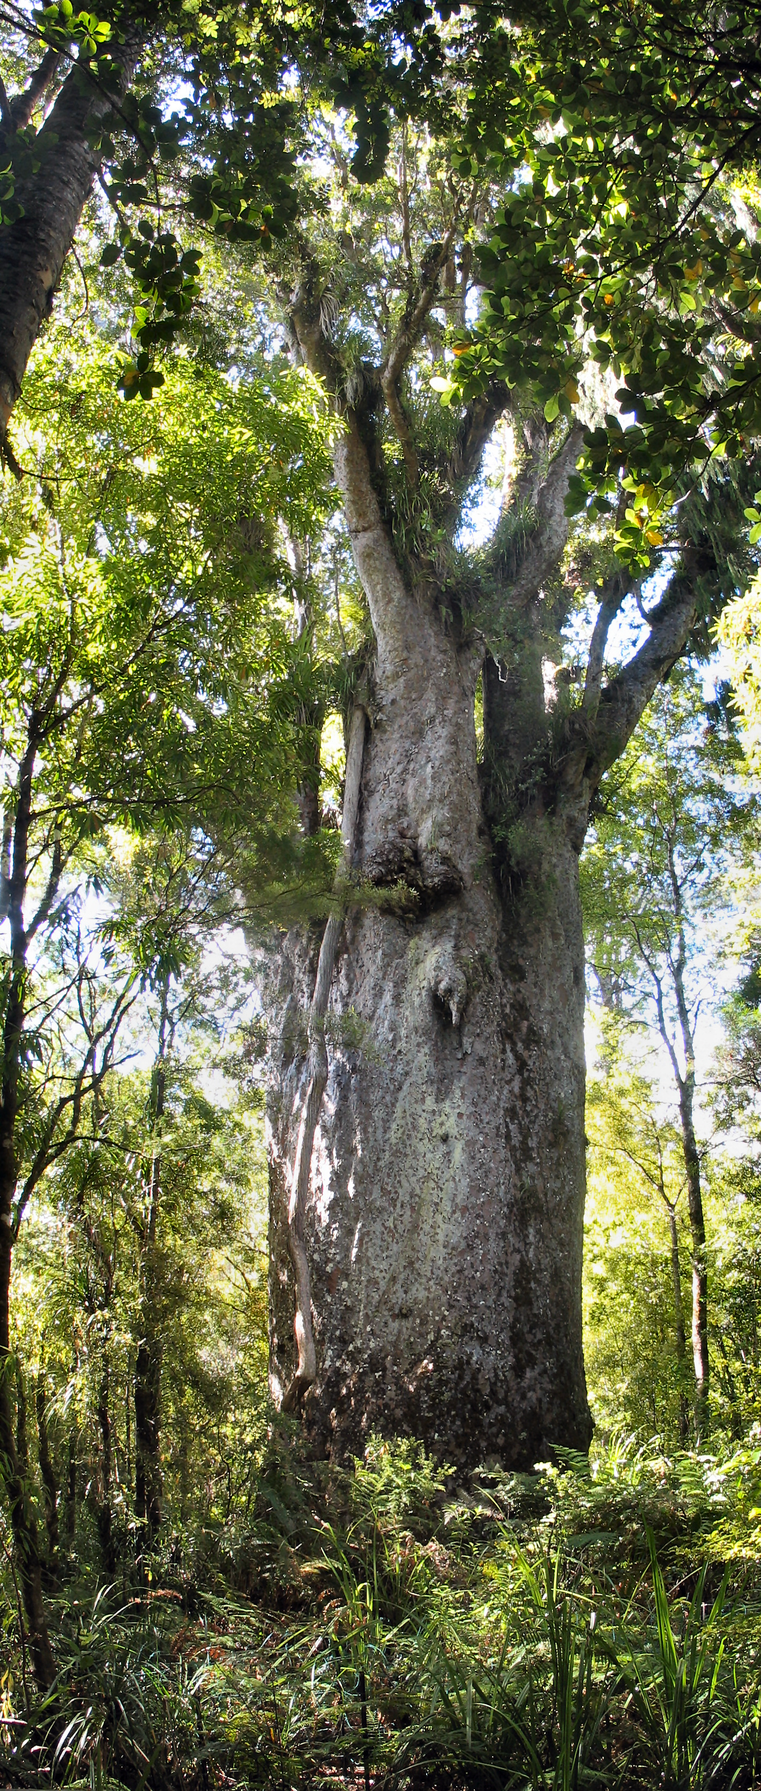
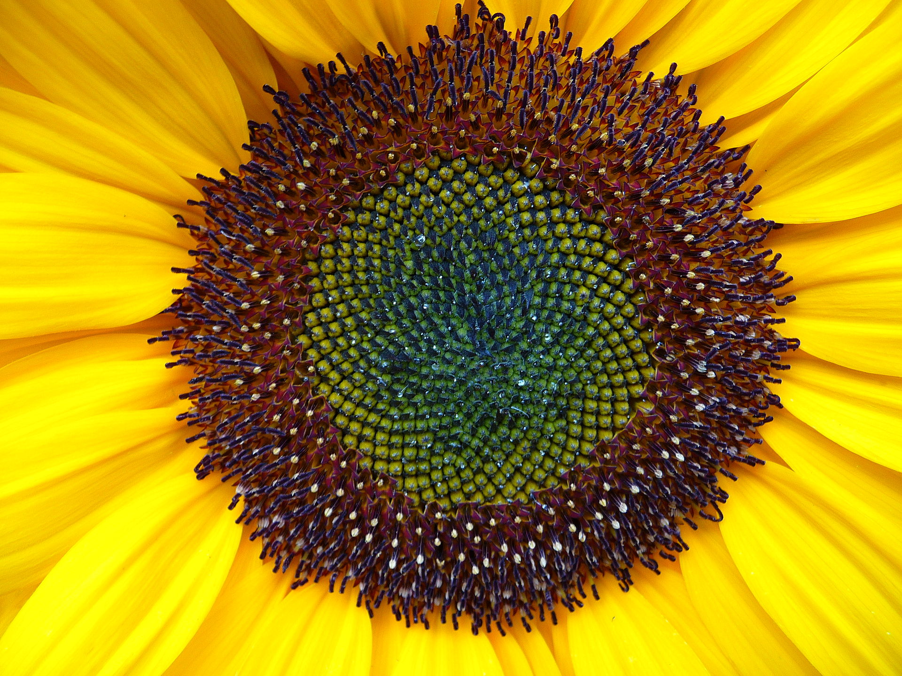
Lesson 4.6: Application: Image Classification
Image features are a way of describing an image using numbers
For example:
How bright is the image (f₁)?
How much yellow is in the image (f₂)?
How much green is in the image (f₃)?
How symmetrical is the image (f₄)?
f₁ | 50%
f₂ | 2%
f₃ | 65%
f₄ | 50%
f₁ | 50%
f₂ | 50%
f₃ | 10%
f₄ | 100%
Notes:
Tree is a Kauri – and this one is the second largest in NZ! Concept slide.

Slide 3
Lesson 4.6: Application: Image Classification
@relation butterfly_vs_owl
@attribute filename string
@attribute f1 numeric
@attribute f2 numeric
@attribute f3 numeric
@attribute class {BUTTERFLY,OWL}
@data
mno001.jpg,3,7,0,BUTTERFLY
mno002.jpg,1,2,0,BUTTERFLY
mno003.jpg,3,4,0,BUTTERFLY
mno004.jpg,6,3,0,BUTTERFLY
owl001.jpg,3,5,0,OWL
owl002.jpg,7,3,0,OWL
owl003.jpg,3,5,0,OWL
owl004.jpg,7,5,1,OWL
Image filters extract the same features for a set of images
@relation butterfly_vs_owl
@attribute filename string
@attribute class {BUTTERFLY,OWL}
@data
mno001.jpg,BUTTERFLY
mno002.jpg,BUTTERFLY
mno003.jpg,BUTTERFLY
mno004.jpg,BUTTERFLY
owl001.jpg,OWL
owl002.jpg,OWL
owl003.jpg,OWL
owl004.jpg,OWL
Image Filter
Notes:
Remind student about ARFF files. Left dataset is unusual – its just filename and class. Right dataset is more standard.

Slide 4
Lesson 4.6: Application: Image Classification
Install imageFilters package using the Package Manager
Create your own ARFF file or use the example at %HOMEPATH%/wekafiles/packages/imageFilter/data
Open the ARFF file in the WEKA Explorer
Select an image filter from filters/unsupervised/instance/imagefilters
Set the filter’s imageDirectory option to the correct directory
Click the Apply button
Repeat 5-7 if you wish to apply more than one filter
(Optional) Remove the first filename attribute
Select a classifier and perform some experiments
Notes:
Show this briefly but switch to WEKA for a demo. Use the butterfly/owls dataset and the MPEG7 Color Layout filter. Use the Naïve Bayes classifier. Say that the steps can be viewed for longer if you download the slides.

Slide 5
Lesson 4.6: Application: Image Classification
Summary
Image features are mathematical properties of images
Image filters can be applied to calculate image features for an entire dataset of images
Different features measure different properties of the image
Experimenting with WEKA can help you identify the best combination of image feature and classifier for your data
References
LIRE: Mathias L., Chatzichristofis S. A. Lire: Lucene Image Retrieval – An Extensible Java CBIR Library. In Proc. of the 16th ACM International Conference on Multimedia, pp. 1085-1088, Vancouver, Canada, 2008
MPEG7 Features: Manjunath B., Ohm J.R., Vasudevan V.V., Yamada A. Color and texture descriptors. IEEE trans. on Circuits and Systems for Video Technology 11,703–715, 2001
Bird images: Lazebnik S., Schmid C., and Ponce J. A Maximum Entropy Framework for Part-Based Texture and Object Recognition. Proceedings of the IEEE International Conference on Computer Vision, Beijing, China, October 2005, vol. 1, pp. 832-838
Butterfly images: Lazebnik S., Schmid C, and Ponce J. Semi-Local Affine Parts for Object Recognition. Proceedings of the British Machine Vision Conference, September 2004, vol. 2, pp. 959-968.
Notes:
Given an example of applying both filters in conjunction. Give an example of using FilteredClassifier to ID the incorrectly predicted image

